Slide 1


HEXAWARE CODE & RISE PROGRAM
SOFT SKILL ENHANCEMENT AI APPLICATION
PRESENTED BY
BLITZKRIEGBOYS_ANAND_INST
Fine-Tune is better than Overloading

Slide 2

Team Details
BLITZKRIEGBOYS_ANAND_INST
NAME
MAIL ID
1
Team Leader
MUGILAN I
antonymugilan46@gmail.com
2
Member
BHUVAN M
m.bhuvanenderan1816@gmail.com
3
Member
SETHURAMAN S
sethu.s3se@gmail.com
4
Member
SAI SURIYA M A
masaisuriya@gmail.com

Slide 3
1 | Provides real-time feedback on pronunciation, tone, and grammar, tailored to individual users' needs.Customizable learning paths to focus on specific soft skills.
2 | Offers scalable training solutions that can be accessed globally. Supports self-paced learning, making it convenient for diverse user groups.
3 | Delivers consistent and unbiased assessments of users' skills . Instant feedback encourages continuous improvement and higher engagement.
4 | Addresses the global demand for effective communication skills in an increasingly interconnected world.Supports lifelong learning, catering to students, professionals, and non-native speakers.
5 | Collects data on common language usage errors and areas needing improvement, enabling targeted content creation.
IMPACT / POTENTIAL VALUE OF THE APPLICATION

Slide 4


Proposed Solution
Develop an AI-powered Soft Skills Enhancement Application that offers personalized learning experiences to improve users' communication abilities. By leveraging advanced language models and real-time feedback, the application provides targeted practice and evaluation to enhance pronunciation, grammar, and public speaking skills.

Slide 5
KEY- FEATURES
Real-Time Pronunciation Feedback
Contextual Tone Analysis Using RAG
Speaking Evaluation
Grammar Enhancement with Fill-in-the-Blanks
Personalized Learning Path
Scalable and User-Friendly

Slide 6






TECHNOLOGIES USED

Slide 7

GEN AI UTILIZATION
t5-base: For error correction of sentences and efficient processing.
Wav2Vec2-base-960h: For speech recognition and pronunciation analysis.
These models work together to provide comprehensive feedback on both written and spoken communication, helping users enhance their soft skills effectively. Users receive instant feedback on their speech and writing, allowing for immediate improvement .Users can improve both their verbal and logical skills, making them more effective in professional and personal interactions.

Slide 8
SYSTEM ARCHITECTURE
Login
Home Page
Progress
Dashboard
Assesments
User chat space
Logical Test
Pronounciation Test
Error Check
Feedback
Suggested Learning Path
Test score

Slide 9

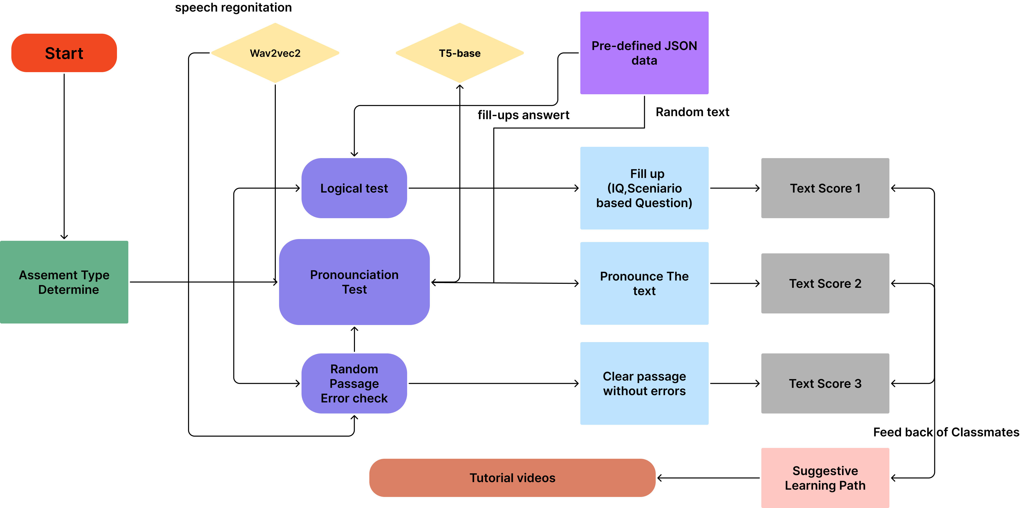
FUNCTIONAL ARCHITECTURE

Slide 10
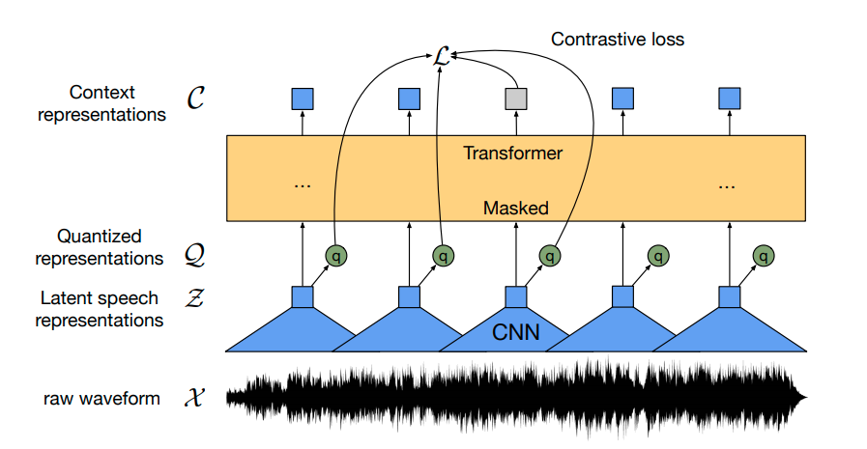
TECHNICAL ARCHITECTURE
Wav2Vec2-base-960h :
1
3

Slide 11
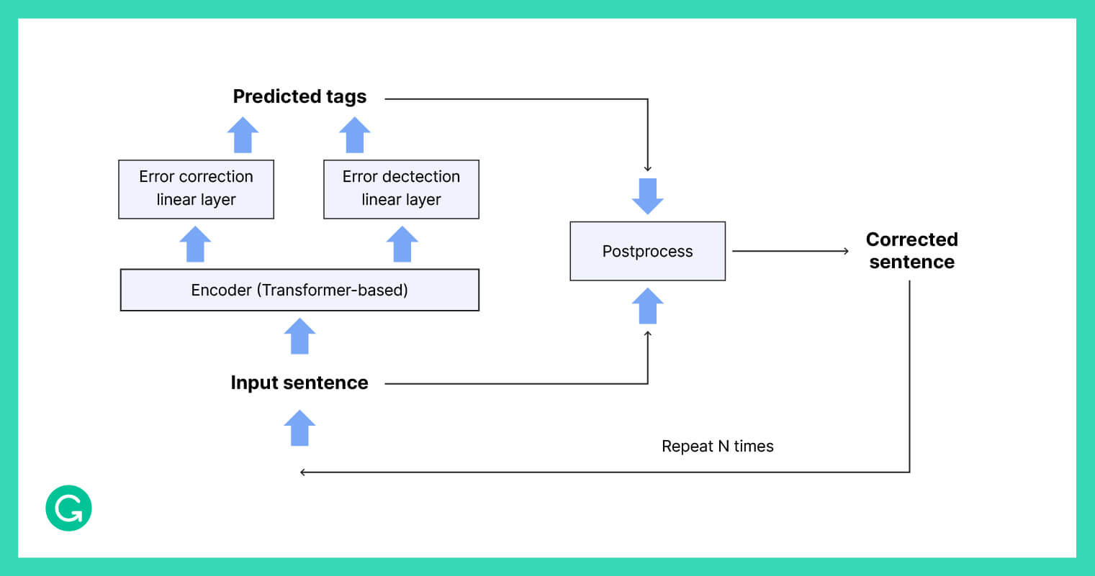
TECHNICAL ARCHITECTURE
t5-base :

Slide 12
1 | Utilizing state-of-the-art AI models like Wav2Vec2 and T5-base to provide real-time, personalized feedback on soft skills.
2 | Combining multiple AI capabilities (speech recognition, error checking, and contextual analysis) to create a holistic learning experience.
3 | Implementing live speech recognition for immediate pronunciation feedback, enhancing learning efficiency.
4 | Using AI to analyze user performance and dynamically adjust the difficulty level and content of exercises, ensuring personalized and effective learning paths
5 | Offering a comprehensive set of assessments, including pronunciation, grammar, tone analysis, and fill-in-the-blanks, catering to various aspects of soft skill development.
INNOVATION AND CREATIVITY

Slide 13
SCALABILITY
Modular Architecture: Utilizing a modular architecture that allows for easy integration of additional features and capabilities without disrupting existing functionality.
Cloud Integration Ready: The system is prepared for future integration with cloud services (e.g., AWS, Azure, GCP) to handle increased user load and storage needs seamlessly.
Microservices-Friendly: Backend to be implemented later using microservices, enabling independent scaling of speech recognition and assessment services as user demand grows.

Slide 14
PERFORMANCE
Optimized AI Models: Using lightweight and efficient versions of AI models (e.g., Wav2Vec2, T5-base) to ensure fast processing times and real-time feedback capabilities..
Asynchronous Processing: Utilizing asynchronous tasks for background processing, minimizing wait times for the user and improving overall application responsiveness.
Hardware Acceleration: Support for GPU acceleration and optimized hardware configurations to boost processing speed and handle complex computations efficiently.

Slide 15
SECURITY
Data Privacy Focus: Commitment to implementing robust data encryption protocols and secure APIs for handling sensitive user data and interactions once backend integration begins.
User Authentication: Plans to implement secure user authentication and access control measures in future backend developments to protect user accounts and personal information.
Compliance and Standards: Future integration will adhere to industry-standard security practices (e.g., GDPR compliance) to ensure the protection of user data and privacy.

Slide 16
BEST PRACTICES AND INDUSTRY STANDARDS FOLLOWS
The Soft Skills Enhancement AI Application adheres to best practices and industry standards to ensure reliability, efficiency, and user trust. By leveraging modular design principles, the application enables flexible and scalable integration of AI agents, which facilitates future enhancements and adaptation to emerging technologies. Emphasis on real-time processing and asynchronous workflows ensures minimal latency and smooth user interactions, providing immediate feedback for effective learning. Adopting secure coding practices and planning for robust encryption methods safeguard user data and privacy. A commitment to continuous monitoring, regular updates, and scalability using cloud services and microservices architecture positions the application for sustainable growth and resilience. It ensures interoperability and maintainability, allowing the application to remain adaptable and relevant in the rapidly evolving field of AI-driven learning solutions.

Slide 17
USER EXPERIENCE
The Soft Skills Enhancement AI Application is designed to provide an intuitive and engaging user experience by leveraging Flask, HTML, and CSS for the frontend. A clean and minimalistic user interface ensures easy navigation, with clearly labeled sections for pronunciation assessment, speaking evaluations, grammar exercises, and tone analysis. The use of responsive design principles makes the application accessible across various devices, including desktops, tablets, and smartphones, ensuring a seamless experience. Real-time feedback is integrated into the user interface, providing immediate and actionable insights, which enhance the learning experience. Interactive elements, such as progress trackers and performance dashboards, keep users informed and motivated throughout their journey. The application employs CSS animations and transitions to create a dynamic and visually appealing interface, making the learning process more engaging. With Flask's flexibility, the application can efficiently handle user interactions and dynamically update content, offering a smooth and responsive experience. The overall user experience is focused on being user-friendly, informative, and conducive to effective skill development.

Slide 18
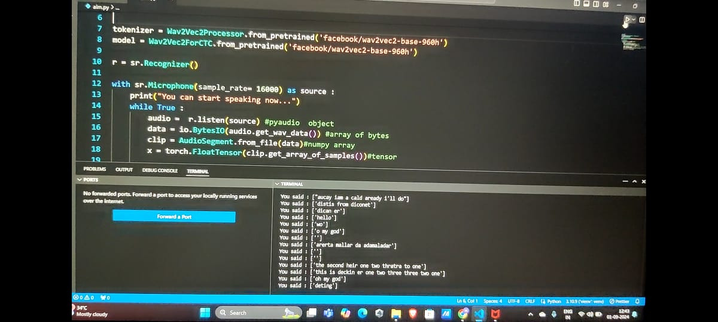
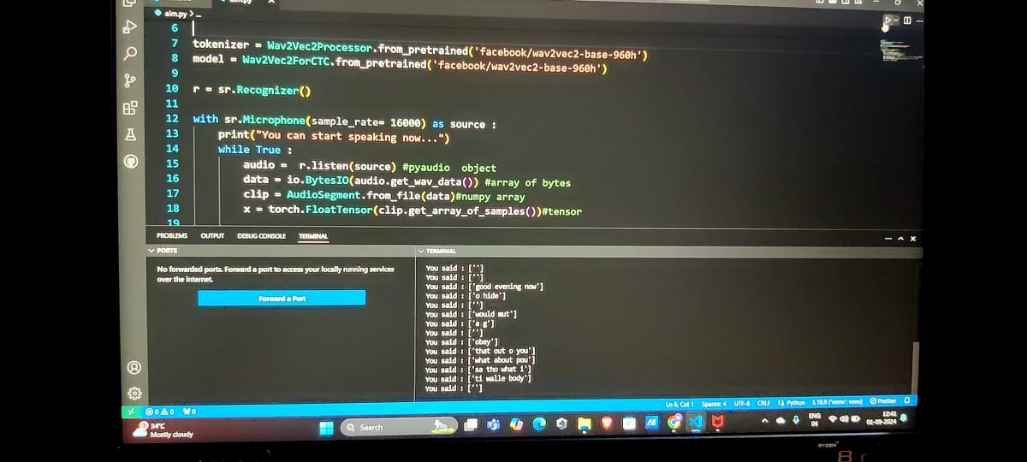
CLI OUTPUT
Live speech-to audio transription output :
( This will be used for pronunciation checking and context analysis to find errors . )

Slide 19
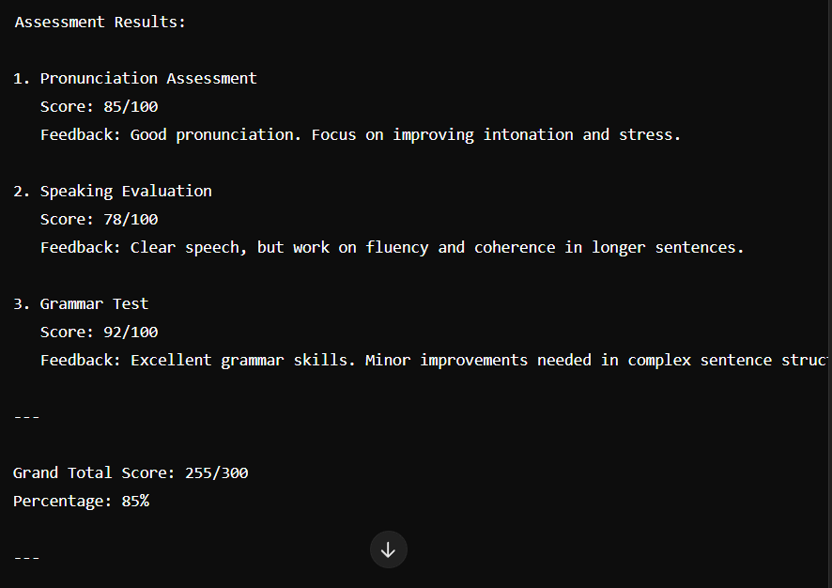
SAMPLE CLI OUTPUT
Assesment results with Feedback :

Slide 20
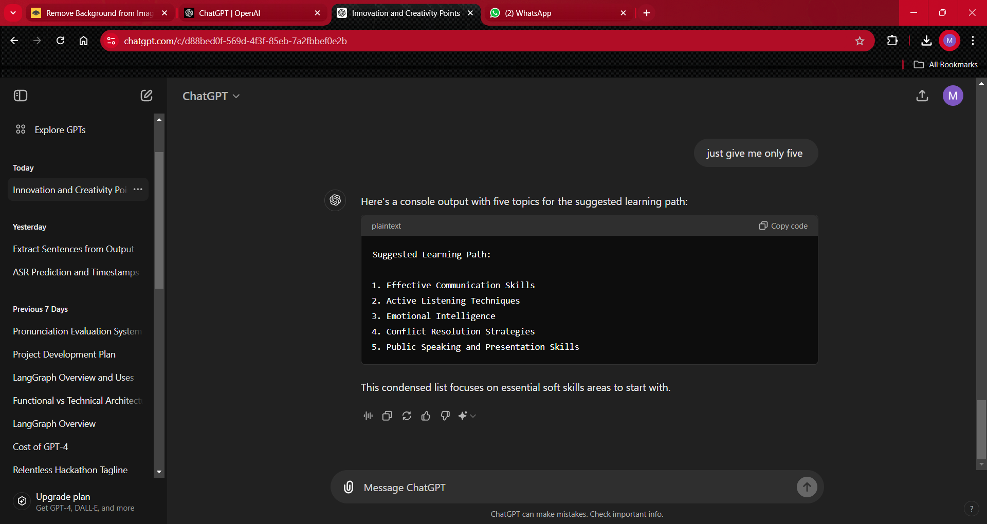
SAMPLE CLI OUTPUT
Suggesting Learning Path :

